Slide 1

SNIPE TEAM
6 January 2018
www.snipe.co.in
1
Notes:
1

Slide 2

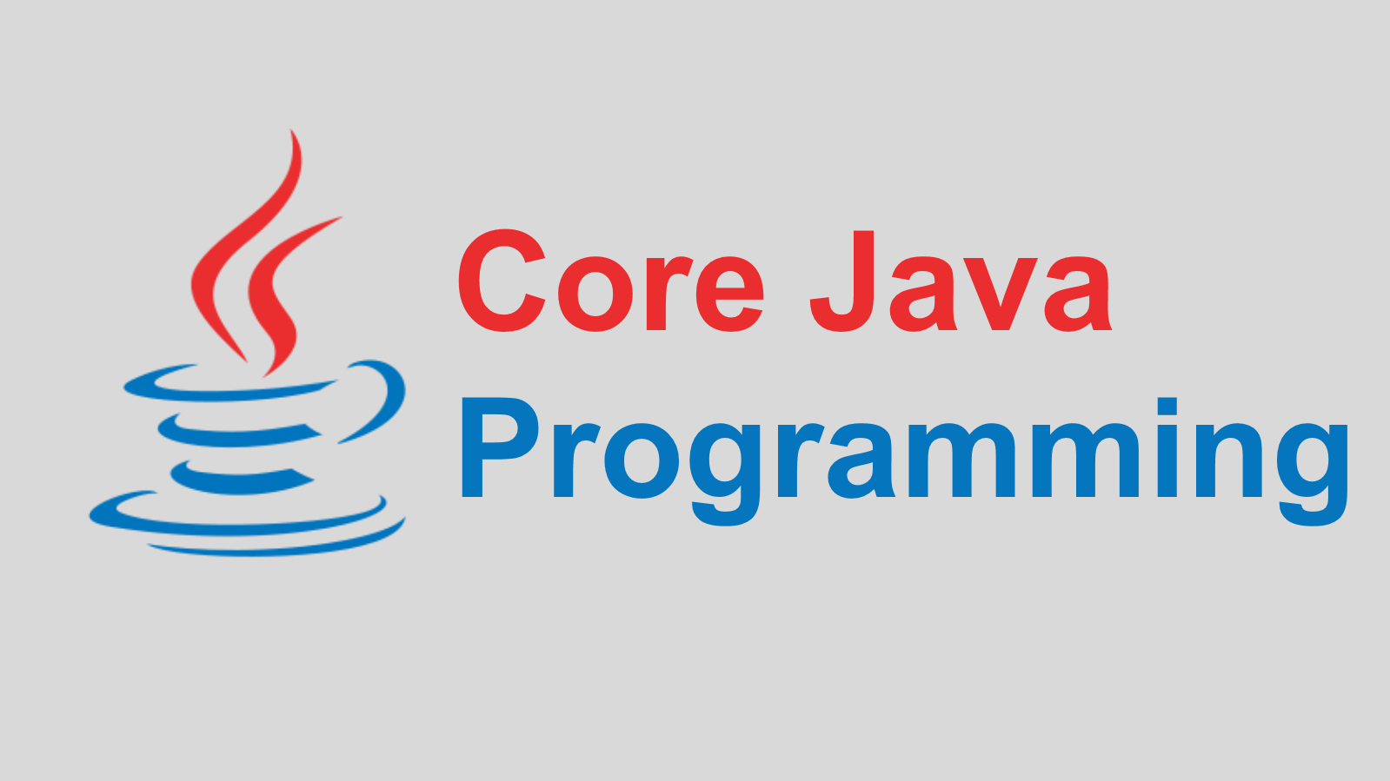

Slide 3
CONTENTS
CONTENTS:
HISTORY
WHY JAVA
GETTING STARTED
FUNDAMENTALS
ARRAY
STRING
COLLECTIONS
GENERICS
MULTI-THREADING
EXCEPTION HANDLING
REGULAR EXPRESSIONS
ANNOTATION
ENUM
FAQ’s

Slide 4

HISTORY
History:
Java is a General Purpose, Object Oriented Programming Language developed by James Gosling at Sun Microsystems in 1991 and released in 1995.
Originally designed for small, embedded systems in electronic appliances like set-top boxes.
There are many java versions that has been released, current stable release of java is Java SE 9 released On 21 September 2017.

Slide 5
WHY JAVA
Why Java:
Simple
Platform Independent
Object Oriented
Robust and Secure
Statically and Strongly typed
Multithreaded
Architectural-Neutral
Interpreted and High Performance
Distributed

Slide 6
GETTING STARTED
Environment Setup:
Java is one of the most popular programming languages used to create Web applications and platforms.
It was designed for flexibility, allowing developers to write code that would run on any machine, regardless of architecture or platform.
Popular Java Editors:
Notepad − On Windows machine, you can use any simple text editor like Notepad or TextPad.
Netbeans − It is a Java IDE that is open-source and free. It can be downloaded from https://netbeans.org/index.html.
Eclipse − It is also a Java IDE developed by the Eclipse open-source community and can be downloaded from https://www.eclipse.org/.

Slide 7
ENVIRONMENT SETUP
JDK, JRE and JVM:
Java Environment includes a large number of development tools and hundreds of classes and methods. and the classes and methods are part of the Java Standard Library (JSL), also known as the Application Programming Interface (API).
JVM: The JVM provides runtime environment in which java bytecode can
be Loaded, Verified and executed.
JRE: It is the implementation of JVM. It physically exists. It contains
set of libraries + other files that JVM uses at runtime.

Slide 8
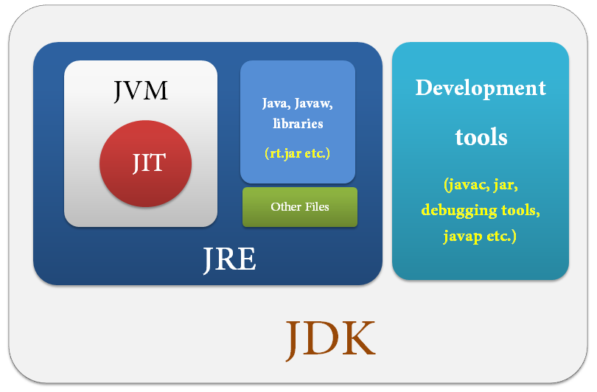
ENVIRONMENT SETUP
JDK, JRE and JVM (Continue… ):
JDK: Java Development Kit comes with a collection of tools that are used for developing and JRE for running Java Programs. JDK officially named "Java Platform Standard Edition (Java SE)", includes a complete JRE plus tools for developing, debugging, and monitoring Java applications.

Slide 9
FUNDAMENTALS
Sample Java Program:
class keyword is used to declare a class ‘SNIPE’ in java.
public keyword is an access modifier which makes visible to all.
static keyword is used to declare method is known as static method.
The core advantage is that there is no need to create object to invoke
the static method. So it saves memory.
void is the return type of the method, it doesn't return any value.
main represents startup of the program.
String[] args is used for command line argument.
System.out.println() is used print statement ‘SNIPE Tech Pvt. Ltd.’.
class Snipe{
public static void main(string[] args)
{
System.out.println("SNIPE Tech Pvt. Ltd.");
} } // O/P - SNIPE Tech Pvt. Ltd.

Slide 10
FUNDAMENTALS
Keywords:
It is a reserved word in programming language which is predefined and cannot be used as name for class, method, function and identifier.
abstract | const | final | interface | strictfp
Assert | continue | finally | long | super
boolean | default | float | native | for
break | do | goto | package | synchronized
case | double | if | private | this
catch | else | implements | public | protected
char | enum | import | instanceof | throws
class | extends | int | short | try
transient | byte | static | while | new
return | void | volatile | switch | throw

Slide 11
FUNDAMENTALS
Variables:
A variable denotes a storage location used to store a data value.
It is defined by the combination of an identifier , a type, and an optional initializer.
Syntax: Example:
Types of Variable:
Local variable - A variable which is declared inside the method.
Instance variable - A variable which is declared inside the class but outside the method and it is not declared as static.
Static variable - A variable that is declared as static. It cannot be local.
type variable-name=value;
int a = 80;

Slide 12
FUNDAMENTALS
Example for different type of variables:
class A{
int data=50; //instance variable
Static int m=100; //static variable
void method(){
int n=90;//local variable
}
} //end of class

Slide 13
FUNDAMENTALS
Data Types:
It is a keyword, represents a kind of data used to allocate sufficient memory space for the data.
Here, speed is a variable, and the data type of the variable is int. The int data type determines that the speed variable can only contain integers.
Data types are classified into two types –
Primitive Data Types
Non-Primitive Data Types
int speed;

Slide 14
FUNDAMENTALS
Description of Data Types:
Data Type | Keyword | Kinds of value | Bytes of Memory | Range of values
Byte | byte | Integer | 1 | -128 to 127
Character | char | 1 character - unicode | 2 | Not applicable
Short integer | short | integer | 2 | -32,768 to 32,767
Integer | int | integer | 4 | -2,147,483,648 to 2,147,483,647
Long integer | long | integer | 8 | -9,223,372,036,854,775,808 to 9,223,372,036,854,775,807
Float | float | Decimal values to 7 decimal digit precision | 4 | 3.4e-38 to 3.4e38
Double | double | Decimal values to 15 decimal digit precision | 8 | 1.7e-308 to 1.73e308
Boolean | boolean | Boolean values True/false | 1 | Not applicable

Slide 15
FUNDAMENTALS
Classifications of Data Types:
DATA TYPES
PRIMITIVE
NON-PRIMITIVE
NUMERIC
NON-NUMERIC
CLASS
INTEGER
FLOATINGPOINT
BOOLEAN
ARRAY
BYTE
INT
FLOAT
STRING
SHORT
LONG
DOUBLE
CHARACTER

Slide 16
FUNDAMENTALS
Operators:
Operator in java is a symbol that is used to perform operations.
Types of Operators in Java:
Operator Type | Precedence
Arithmetic Operator | +, -, *, /, %, ++, += , -=, *=, /= ,%= , --
Bitwise Operator | ~, &, |, ^, >>, >>>, <<, &=, |=, ^=, >>=, >>>=, <<=
Relational Operator | ==, !=, >, <, >=, <=
Logical Operators | ||, &&, !
Assignment Operator | =
Ternary Operator | ? :

Slide 17
FUNDAMENTALS
Example for operators:
public class ArithmeticDemo {
public static void main(String[] args) {
int x = 10;
int y = 20;
int result = x + y;
System.out.println("x + y = " + result); // O/P- x + y = 30
result = x - y;
System.out.println("x - y = " + result); // O/P- x - y = -10
result = x * y;
System.out.println("x * y = " + result); // O/P- x * y = 200
result = y / x;
System.out.println("y / x = " + result); // O/P- y / x = 2
result = x % 3;
System.out.println("x % 3 = " + result); // O/P- x + 3 = 1
}
}

Slide 18
FUNDAMENTALS
Control Statements:
if statement :
‘if’ is used to perform conditional checks.
It checks boolean condition: true or false.
There are various types:
‘if’ statement
‘if-else’ statement
‘if-else-if’ ladder
‘nested if’ statement
Syntax:
if(condition) {
statement 1;
} else {
statement 2;
}
statement X;

Slide 19
FUNDAMENTALS
Control Statements (Continue..) :
switch/case : Switch statement is used
to execute a particular set of statements
among multiple conditions.
for : for loop is used to execute a set of statements multiple times.
There are three types of for loop in java.
Simple for loop
for-each or enhanced for loop
labeled for loop
Syntax:
switch(expression){
case value1:
//code to be executed;
break; //optional
case value2:
//code to be executed;
break; //optional
......
default:
code to be executed if all cases are not matched;}
Syntax:
for(initialization; condition; increment/decrement)
{
Statement 1:
}

Slide 20
FUNDAMENTALS
Control Statements (Continue..) :
while : It is an entry controlled loop. In while, 1st condition will be verified. If the condition is true, loop will be repeated. If the condition is false then control come out of the loop.
do-while : It is a exit controlled loop. In do-while, 1st all the statements inside the block will be executed and then condition will be verified.
Example:
class WhileDemo {
public static void main(String[] args) { int i = 1;
while (i <= 3) {
System.out.println("Num is: " + i);
i++; } }
} /* O/P – 1
2
3 */
class DoWhileDemo {
public static void main(String[] args) { int i = 11;
do {
System.out.println("Num is: " + i);
i++;
} while (i <= 10);
}
} // O/P – 11

Slide 21
FUNDAMENTALS
Control Statements (Continue..) :
break – It helps to transfer control to another part of the program.
continue – It is used when you want to continue running the loop with the next iteration and want to skip the rest of the statements of the body for the current iteration.
return – It terminates the execution in a method and return the control to the caller method.
Example:
public class BreakDemo {
public static void main(String[] args) {
for(int i=1;i<=10;i++) {
if(i==4) {
break; }
System.out.println(i);
} } } /* O/P – 1
2
3 */
public class BreakDemo {
public static void main(String[] args) {
for(int i=1;i<=4;i++) {
if(i==2) {
continue; }
System.out.println(i);
} } } /* O/P – 1
3
4 */

Slide 22
FUNDAMENTALS
Identifiers :
Identifiers are used for class names, method names, variable names.
An identifier must start with uppercase and lowercase letters, numbers, or the underscore and dollar-sign characters.
Valid Identifiers:
Invalid Identifiers:
Literals:
A constant value in java is created by using a literal representation of it.
AvgTemp | count | a4 | $test | this_is_ok
2count | high-temp | Not/ok
100 | 98.6 | ‘X’ | “This is test”

Slide 23
OOPS CONCEPTS
Object-Oriented Programming:
It is a methodology or paradigm to design a program using classes and objects. It simplifies the software development and maintenance by providing various concepts:
Object
Class
Inheritance
Polymorphism
Abstraction
Encapsulation

Slide 24
OOPS CONCEPTS
Object:
An entity that has state and behavior is known as an object.
It can be physical or logical. Example: chair, bike, marker, pen, table, car etc.
An object has three characteristics:
State: It represents data (value) of an object.
Behavior: It represents the behavior (functionality) of an object such as deposit, withdraw etc.
Identity : It gives a unique name to an object and enables one object to interact with other objects.

Slide 25
OOPS CONCEPTS
Class:
A class is a group of objects which have common properties.
It is a template or blueprint from which objects are created.
A class contains:
fields
methods
constructors
blocks
nested class and interface
Syntax:
class <class_name> {
field;
method;
}

Slide 26
OOPS CONCEPTS
Constructor:
It is a special method having same name of class having no return type, used to initialize the instance members and the object.
Types of constructor:
Default constructor -
A constructor that have no parameter is known as default constructor.
Parameterized constructor - A constructor that have parameters is known as parameterized constructor.
syntax: <class_name> () {}
syntax: <class_name>(parameters) {}

Slide 27
OOPS CONCEPTS
Inheritance:
It is a mechanism in which one object acquires all the properties and behaviors of parent object.
Inheritance represents the IS-A relationship, also known as parent-child relationship.
Why inheritance in java
For Method Overriding (so runtime polymorphism can be achieved).
For Code Reusability.
Syntax:
Class Superclass-name
{
//methods and fields
}
class Subclass-name extends Superclass-name
{
//methods and fields
}

Slide 28
OOPS CONCEPTS
Types of Inheritance:
Single Inheritance
Multilevel Inheritance
Hierarchical Inheritance
CLASS A
CLASS A
CLASS A
CLASS B
CLASS B
CLASS B
CLASS C
Single
Hierarchical
CLASS C
Multilevel

Slide 29
OOPS CONCEPTS
Example for Inheritance:
class Animal {
Void eat() {
System.out.println("eating..."); }
}
class Dog extends Animal {
void bark() {
System.out.println("barking..."); }
}
class TestInheritance {
public static void main(String args[]) {
Dog d=new Dog();
d.bark();
d.eat();
}} /* O/P - barking…
eating… */

Slide 30
OOPS CONCEPTS
Encapsulation :
Encapsulation in java is a process of wrapping data and the methods together into a single unit.
The Java Bean class is the example of fully encapsulated class.
Example:
//save as Student.java
package com.pack;
public class Student {
private String name;
public String getName() {
return name;
}
public void setName(String name) {
this.name=name
} }
//save as Test.java
package com.pack1;
class Test{
public static void main(String[] args) {
Student s=new Student();
s.setName("vijay");
System.out.println(s.getName());
}
} // O/P - vijay

Slide 31
OOPS CONCEPTS
Access Modifiers:
It specifies accessibility (scope) of a data member, method, constructor or class.
There are 4 types of access modifiers:
Private : Accessible only within class.
Default : Accessible only within package.
Protected : Accessible within package and outside the package but through inheritance only.
Public : Accessible everywhere. It has the widest scope among all other modifiers.

Slide 32
OOPS CONCEPTS
Polymorphism:
It is a concept by which we can perform a single action by different ways.
Types of Polymorphism:
Compile time polymorphism
Runtime polymorphism.
It perform in java by method overloading and method overriding.

Slide 33
OOPS CONCEPTS
Method Overloading:
A class has multiple methods having same name but different in parameters. It increases the readability of the program
Example:
class Adder {
static int add(int a,int b) {
return a+b; }
static int add(int a,int b,int c) {
return a+b+c; }
}
class TestOverloading1 {
public static void main(String[] args) {
System.out.println(Adder.add(11,11)); // O/P – 22
System.out.println(Adder.add(11,11,11)); // O/P - 33
}}

Slide 34
OOPS CONCEPTS
Method Overriding:
Subclass provides the specific implementation of the method that has been provided by one of its parent class.
Example:
class Vehicle {
Void run() {
System.out.println("Vehicle is running"); }
}
class Bike2 extends Vehicle {
void run() {
System.out.println("Bike is running safely"); }
public static void main(String args[]) {
Vehicle obj = new Bike2();
obj.run();
} // O/P – Bike is running safely

Slide 35
OOPS CONCEPTS
Abstraction:
It is the process of hiding certain details and only show essential features of the object.
Abstraction in Java is achieved by using abstract class and interface.
Abstract class in Java:
A class that is declared as abstract is known as abstract class.
It needs to be extended and its method implemented. It cannot be instantiated.
Example: abstract class A{}

Slide 36
OOPS CONCEPTS
Example for Abstract class:
abstract class Bank {
abstract int getRateOfInterest();
}
class SBI extends Bank {
int getRateOfInterest() {
return 9; }
}
class PNB extends Bank{
int getRateOfInterest() {
return 10; }
}
class TestBank {
public static void main(String args[]) {
Bank b;
b=new SBI();
System.out.println("Rate of Interest is: "+b.getRateOfInterest()+" %");
b=new PNB();
System.out.println("Rate of Interest is: "+b.getRateOfInterest()+" %");
}} /* O/P - Rate of Interest is: 9 %
Rate of Interest is: 10 % */

Slide 37
OOPS CONCEPTS
Interface:
It is an abstract type that is used to specify a behaviour that classes must implement.
Interfaces are declared using the interface keyword, and may only contain method signature and constant declarations. All methods of an Interface do not contain implementation (method bodies).
Advantages of interface:
Used to achieve abstraction
Support the functionality of multiple inheritance.

Slide 38
OOPS CONCEPTS
Example for Interface:
interface printable{
void print();
}
class A1 implements printable {
public void print() {
System.out.println("Hello"); }
public static void main(String args[])
{
A1 obj = new A1();
obj.print();
} } // O/P - Hello

Slide 39
ARRAYS
Arrays:
It is an indexed collection of fixed number of homogeneous data elements. Once created with some size, we can’t alter the size.
It can store both primitive data and objects.
Represent multiple values with a single variable. So that reusability of the code will be improved.
A specific element in an array is accessed by its index.
We can add elements into array and can’t insert an element into specified index of an array.
It may have one or more dimensions.

Slide 40
ARRAYS
Single dimension arrays:
Syntax : type[] var-name; or
type var-name[]; or
type []var-name;
Program: Average an array of values:
class Average
{
public static void main(String args[]) {
double nums[] = {10.1, 11.2, 12.3, 13.4, 14.5};
double result = 0;
int i;
for(i=0; i<5; i++)
result = result + nums[i];
System.out.println("Average is " + result / 5);
}
} // O/P – Average is 12.29..
Example : int[] a = new int[2];
a[0]= 10;
a[1]= 20;
int a[] = {10, 20};
int []a = new int[]{10,20};

Slide 41
ARRAYS
Two-dimensional arrays:
These are arrays of arrays.
To declare a two dimensional array variable,
specify each additional index using another
set of square brackets.
Program: 2D Print
Class twodimensional
{
public static void main(String args[]) {
int arr[][] = {{1,2,3},{4,5,6},{7,8,9}};
for (int i=0; i< 3 ; i++) {
for (int j=0; j < 3 ; j++)
System.out.print(arr[i][j] + " ");
System.out.println();
}
}
}
/* O/P - 1 2 3
4 5 6
7 8 9 */
Syntax : type[][] var-name; or
type var-name[][];
Example : int[][] a = new int[2][3];
int a[][] = {{10, 20},{30,40}};

Slide 42
STRING
String:
It is an object that represents a sequence of characters.
The CharSequence interface is used to represent sequence of characters. It is implemented by String, StringBuffer and StringBuilder classes.
Objects of String are immutable and fixed in length.
The java.lang.String class is used to create string object.
It uses to make Java more memory efficient.
It is used to have constants in program.

Slide 43
STRINGS
Two ways to create String object: (With ‘new’ or without ‘new’)
1. By string literal 2. By new keyword
Syntax: String s=“Welcome"; String s=new String("Welcome");
Example:
public class StringExample {
public static void main(String args[]) {
String s1="java"; //creating string by java string literal
char ch[]={'s','t','r','i','n','g','s'};
String s2=new String(ch); //converting char array to string
String s3=new String("example"); //creating java string by new keyword
System.out.println(s1); // O/P - java
System.out.println(s2); // O/P - strings
System.out.println(s3); // O/P - example
}}

Slide 44
STRINGS
Methods of String:
Modifier and Type | Method | Modifier and Type | Method
public char | charAt(int index) | public boolean | contains(CharSequence s)
public int | length() | public boolean | equals(Object another)
public int | indexOf(int ch) | public String | substring(int beginIndex)
public int | indexOf(int ch, int fromIndex) | public String | substring(int beginIndex, endIndex)
public int | indexOf(String substring) | public String | concat(String str)
public int | indexOf(String substring, int fromIndex) | public String | replace(char old, char new)

Slide 45
STRINGS
Methods of String: (Continue..)
Modifier and Type | Method | Modifier and Type | Method
public String | replace(CharSequence old, CharSequence new) | public String | trim()
public String | intern() | public String[] | split(String regex)
public String | toLowerCase() | public String[] | split(String regex, int limit)
public String | toLowerCase(Locale l) | static String | format(String format, Object… args)
public String | toUpperCase() | static String | format(Locale l, String format, Object... args)
public String | toUpperCase(Locale l) | static String | valueOf(int value)

Slide 46
STRINGS
Example for methods in String:
public class Test {
public static void main(String[] args) {
String s= "Snipe IT Solutions";
System.out.println("length = " + s.length()); // O/P – length = 18
System.out.println("At 3rd position = " + s.charAt(3)); // O/P - At 3rd position = p
System.out.println("Substring = " + s.substring(3,5)); // O/P - Substring = pe
String s1 = "Snipe";
String s2 = "Tutorials";
System.out.println("Concatenated string = " + s1.concat(s2)); /* O/P - Concatenated string =
Snipe Tutorials */
System.out.println("Index of a = " + s.indexOf('s',1)); // O/P - Index of a = 17
int out1 = s2.compareTo(s1);
System.out.println("If s1 = s2 " + out1); // O/P - If s1 = s2 1
System.out.println("Changing to upper Case = " + s1.toUpperCase()); /* O/P - Changing to upper
Case = SNIPE */
String s3 = "SNYPE".replace(‘Y' ,’I') ;
System.out.println("Replaced Y with I -> " + s3); // O/P - Replaced Y with I -> SNIPE
} }

Slide 47
STRINGS
StringBuffer:
Objects of String are mutable and not fixed in length and should be created only with “new” operator.
Every method present in StringBuffer is synchronized.
Java StringBuffer class is thread-safe i.e. multiple threads cannot access it simultaneously. So it is safe and will result in an order.
It increases waiting time of threads. Hence relatively performance is low.
StringBuffer defines three constructors:
StringBuffer( ) Ex: StringBuffer s = new StringBuffer();
StringBuffer(int size) Ex: StringBuffer s = new StringBuffer(10);
StringBuffer(String str) Ex: StringBuffer s = new StringBuffer("SNIPE”);

Slide 48
STRINGS
Important Methods of StringBuffer class:
Modifier and Type | Method | Modifier and Type | Method
public synchronized StringBuffer | append(String s) | public int | capacity()
public synchronized StringBuffer | insert(int offset, String s) | public char | charAt(int index)
public synchronized StringBuffer | replace(int startIndex, int endIndex, String str) | public int | length()
public synchronized StringBuffer | delete(int startIndex, int endIndex) | public String | substring(int beginIndex)
public synchronized StringBuffer | reverse() | public String | substring(int beginIndex, int endIndex)

Slide 49
STRINGS
Example for methods in StringBuffer class:
public class Test {
public static void main(String[] args) {
StringBuffer sb=new StringBuffer("SNIPE ");
System.out.println(sb.append("Solutions")); // O/P – SNIPE Solutions
System.out.println(sb.insert(5," IT")); // O/P – SNIPE IT Solutions
System.out.println(sb.replace(10,11,"a")); // O/P - SNIPE IT Salutions
System.out.println(sb.delete(17,18)); // O/P - SNIPE IT Salution
System.out.println(sb.charAt(4)); // O/P - E
System.out.println(sb.substring(6)); // O/P - IT Salution
System.out.println(sb.substring(6, 8)); // O/P - IT
System.out.println(sb.reverse()); // O/P - noitulaS TI EPINS
System.out.println(sb.length()); // O/P - 17
System.out.println(sb.capacity()); // O/P - 22
}
}

Slide 50
STRINGS
StringBuilder:
The Java StringBuilder class is same as StringBuffer class except that it is non-synchronized and is not thread-safe
StringBuilder is more efficient than StringBuffer.
Threads are not required to wait to operate in StringBuilder object. Hence relatively performance is high.
StringBuilder defines three constructors:
StringBuilder( ) Ex: StringBuilder s = new StringBuilder();
StringBuilder(int length) Ex: StringBuilder s = new StringBuilder(10);
StringBuilder(String str) Ex: StringBuilder s = new StringBuilder("SNIPE”);

Slide 51
STRINGS
Important Methods of StringBuilder class:
Modifier and Type | Method | Modifier and Type | Method
public StringBuilder | append(String s) | public int | capacity()
public StringBuilder | insert(int offset, String s) | public char | charAt(int index)
public StringBuilder | replace(int startIndex, int endIndex, String str) | public int | length()
public StringBuilder | delete(int startIndex, int endIndex) | public String | substring(int beginIndex)
public StringBuilder | reverse() | public String | substring(int beginIndex, int endIndex)

Slide 52
STRINGS
Example for methods in StringBuilder class:
public class Test {
public static void main(String[] args) {
StringBuilder sb=new StringBuilder("SNIPE ");
System.out.println(sb.append("Solutions")); // O/P – SNIPE Solutions
System.out.println(sb.insert(5," IT")); // O/P – SNIPE IT Solutions
System.out.println(sb.replace(10,11,"a")); // O/P - SNIPE IT Salutions
System.out.println(sb.delete(17,18)); // O/P - SNIPE IT Salution
System.out.println(sb.charAt(4)); // O/P - E
System.out.println(sb.substring(6)); // O/P - IT Salution
System.out.println(sb.substring(6, 8)); // O/P - IT
System.out.println(sb.reverse()); // O/P - noitulaS TI EPINS
System.out.println(sb.length()); // O/P - 17
System.out.println(sb.capacity()); // O/P - 22
}}

Slide 53
STRINGS
String vs StringBuffer vs StringBuilder in Java
Example:
class Test {
public static void concat1(String s1) {
s1 = s1 + "IT Solutions"; }
public static void concat2(StringBuffer s2) {
s2.append(" IT Solutions "); }
public static void concat3(StringBuilder s3) {
s3.append(" IT Solutions "); }
public static void main(String[] args) {
String s1 = "SNIPE";
concat1(s1); // s1 is not changed System.out.println("String: " + s1); // O/P – String: SNIPE
StringBuffer s2 = new StringBuffer("SNIPE ");
concat2(s2); // s2 is changed
System.out.println("StringBuffer: " + s2); // O/P – StrigBuffer: SNIPE IT Solutions StringBuilder s3 = new StringBuilder("SNIPE ");
concat3(s3); // s3 is changed
System.out.println("StringBuilder: " + s3); // O/P – StrigBuilder: SNIPE IT Solutions
}}

Slide 54
COLLECTIONS
Collections:
Collections in java is a framework that provides an architecture to store and manipulate the group of objects.
Collections are growable in nature.
Collections can hold both homogeneous and heterogeneous elements.
Difference b/w Collection and Collections is Collections is an utility class present in java.util.package to define several utility methods (like Sorting, Searching..) for Collection objects.
Every collection class is implemented based on some standard data structure.
Hence readymade method support is available for every requirement.

Slide 55
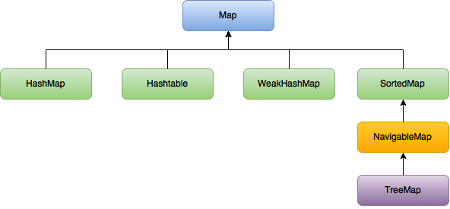
COLLECTION FRAMEWORK
Hierarchy of Collection Framework

Slide 56
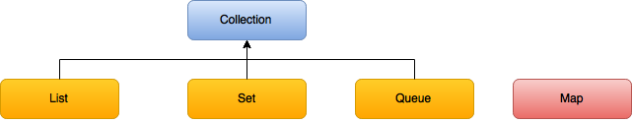
COLLECTION FRAMEWORK
Key Interfaces of Collection Framework:
1) Collection Interface :
Collection represents a single unit of objects. i.e a group. and To represent a group of individual objects as single entity.
Collection interface defines the most common methods which are applicable for any Collection object and is considered as root interface of Collection Framework.

Slide 57
COLLECTION FRAMEWORK
Methods of Collection Interface:
Modifier and Type | Method | Modifier and Type | Method
public boolean | add(Object element) | public boolean | contains(Object element)
public boolean | addAll(Collection c) | public boolean | containsAll(Object element)
public boolean | remove(Object element) | public int | size()
public boolean | removeAll(Collection c) | public void | clear()
public boolean | retainAll(Collection c) | public Iterator | iterator()
public boolean | isEmty() | public Object[] | toArray()
public boolean | equals(Object element) | public int | hashCode()

Slide 58
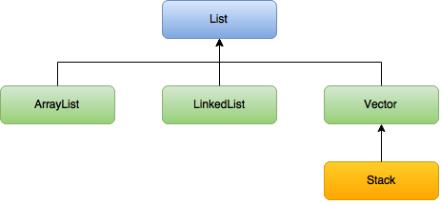
COLLECTION FRAMEWORK
2) List Interface :
List interface extends the Collection interface to provides the functionality to store and manage a sequence of items.
It contains methods to insert and delete elements in index basis. It is a factory of ListIterator interface
List is useful for represent a group of individual objects as a single entity where duplicates are allowed and insertion order preserved.

Slide 59
COLLECTION FRAMEWORK
Declaration of List Interface:
public interface List<E> extends Collection<E>
Methods of List Interface:
Modifier and Type | Method | Modifier and Type | Method
public void | add(int index, Object element) | public object | remove(int index)
public boolean | addAll(int index, Collection c) | ListIterator | listIterator()
public object | get(int index) | ListIterator | listIterator(int index)
public object | set(int index, Object element)

Slide 60
COLLECTION FRAMEWORK
ArrayList:
Java ArrayList class uses a dynamic array for storing the elements.
It inherits AbstractList class and implements List interface.
The important points about Java ArrayList class are:
It can contain duplicate elements.
It class maintains insertion order.
It is non synchronized.
The underlined date structure is Resizable Array or Growable Array.
It allows Heterogeneous objects.
It allows Random Access because array works at the index basis.
In Java ArrayList class, manipulation is slow because a lot of shifting needs to be occurred if any element is removed from the array list.

Slide 61
COLLECTION FRAMEWORK
Declaration of ArrayList:
public class ArrayList<E> extends AbstractList<E> implements List<E>
Constructors of ArrayList:
ArrayList()
ArrayList(Collection c)
ArrayList(int capacity)
Hierarchy of ArrayList class

Slide 62
COLLECTION FRAMEWORK
Methods of ArrayList:
Modifier and Type | Method | Modifier and Type | Method
public boolean | addAll(Collection c) | public int | lastIndexOf(Object ele)
public boolean | add(Object ele) | public int | indexOf(Object ele)
public boolean | addAll(int index, Collection c) | public Object[] | toArray()
public void | add(int index, Object element) | public Object[] | toArray(Object[] a)
public void | clear() | public Object | clone()
public void | trimToSize()

Slide 63
COLLECTION FRAMEWORK
Example for ArrayList:
import java.util.*;
Class ArrayListDemo {
public static void main(String args[]){
ArrayList I = new ArrayList();
I.add("A");
I.add(10);
I.add("A");
I.add(null);
System.out.println(I); // O/P – [A, 10, A, null]
I.remove(2);
System.out.println(I); // O/P – [A, 10, null]
I.add("2", "B");
I.add("C");
System.out.println(I); // O/P – [A, 10, B, null, C]
}}

Slide 64
COLLECTION FRAMEWORK
LinkedList:
Java LinkedList class uses doubly linked list to store the elements. It provides a linked-list data structure. It inherits the AbstractList class and implements List and Deque interfaces.
The important points about Java LinkedList are:
It can contain duplicate elements.
It maintains insertion order.
It is non synchronized.
In Java LinkedList class, manipulation is fast because no shifting needs to be occurred.
Java LinkedList class can be used as list, stack or queue.

Slide 65
COLLECTION FRAMEWORK
public class LinkedList<E> extends AbstractSequentialList<E> implements List<E> , Deque<E>, Cloneable, Serializable
Constructors of LinkedList:
Declaration of LinkedList:
LinkedList()
LinkedList(Collection c)
Hierarchy of LinkedList class

Slide 66
COLLECTION FRAMEWORK
Methods of LinkedList:
Modifier and Type | Method | Modifier and Type | Method
public boolean | contains(Object o) | public int | size()
public boolean | add(Object o) | public int | indexOf(Object o)
public boolean | remove(Object o) | public int | lastIndexOf(Object o)
public void | add(int index, Object element) | public Object | getFirst()
public void | addFirst(Object o) | public Object | getLast()
public void | addLast(Object o)

Slide 67
COLLECTION FRAMEWORK
Example for LinkedList:
import java.util.*;
Class LinkedListDemo {
public static void main(String args[]){
ArrayList I = new ArrayList();
I.add("A");
I.add(10);
I.add("A");
I.add(null);
System.out.println(I); // O/P – [A, 10, A, null]
I.remove(2);
System.out.println(I); // O/P – [A, 10, null]
I.add("2", "B");
I.add("C");
System.out.println(I); // O/P – [A, 10, B, null, C]
}}

Slide 68
COLLECTION FRAMEWORK
Vector:
Vector implements List interface and maintains insertion order.
Vector is synchronized. Hence Vector class is mainly useful for multithreaded environment, since all the methods implemented in Vector class.
It allows Duplicate objects, Heterogeneous objects and ‘null’ insertion.
The Vector class implements a growable array of objects. Vector doubles the array size if total number of elements exceeds than its capacity.

Slide 69
COLLECTION FRAMEWORK
Vector<String> myVector = new Vector<String>();
Constructors of Vector:
Declaration of Vector:
Vector()
Vector(int size)
Vector(int size, int incr)
Vector(Collection c)

Slide 70
COLLECTION FRAMEWORK
Methods of Vector:
Modifier and Type | Method | Modifier and Type | Method
public boolean | add(Object o) | public int | size()
public boolean | remove(Object o) | public int | capacity()
public void | add(int index, Object o) | public Object | get(int index)
public void | addElement(Object o) | public Object | elementAt(int index)
public void | remove(Object o) | public Object | firstElement()
Public void | removeElement(Object o) | public Object | lastElement()

Slide 71
COLLECTION FRAMEWORK
Example for Vector:
import java.util.*;
Class VectorDemo {
public static void main(String args[]){
Vector v = new Vector();
System.out.println(v.capacity()); // O/P – [ 10]
for(int i=0;i<10;i++) {
v.addElement(i);
}
System.out.println(v.capacity()); // O/P – [ 10]
v.addElement("A");
System.out.println(v.capacity()); // O/P – [ 20]
v.addElement(v);
}}

Slide 72
COLLECTION FRAMEWORK
Stack:
Stack class is a collection that is based on the Last In First Out (LIFO) principle.
Constructor of Stack:
Methods of Stack:
Stack()
Modifier and Type | Method | Modifier and Type | Method
public Object | push(Object ele) | public Object | peek()
public Object | pop() | public int | search(Object ele)

Slide 73
COLLECTION FRAMEWORK
Example for Stack:
import java.util.*;
Class StackDemo {
public static void main(String args[]){
Stack s = new Stack();
s.push("A");
s.push("B");
s.push("C");
System.out.println(s); // O/P – [ A,B,C]
System.out.println(s.search("A")); // O/P – [ 3]
System.out.println(s.search("Z")); // O/P – [ -1]
}
}

Slide 74
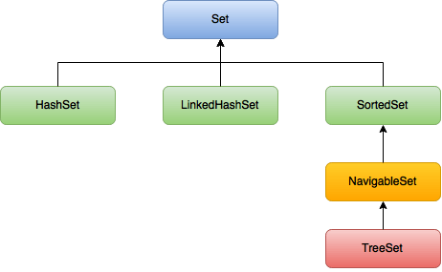
COLLECTION FRAMEWORK
3) Set Interface:
Set interface is a generic interface that extends the Collection interface.
It provides the functionality to store and manage a set of elements and does not provide any additional methods.
Set is useful for represent a group of individual objects as a single entity where duplicates are not allowed and insertion order not preserved.

Slide 75
COLLECTION FRAMEWORK
HashSet:
Java HashSet class is used to create a collection that uses a hash table for storage. It inherits the AbstractSet class and implements Set interface.
The important points about Java HashSet class are:
It stores the elements by using a mechanism called hashing.
It contains unique elements only and ‘null’ insertion is possible.
It allows Heterogeneous objects and not allow Duplicate objects.
It implements Serializable and Cloneable interface but not Random Access.
Insertion order is not preserved and all objects will be inserted on hash-code
of objects.

Slide 76
COLLECTION FRAMEWORK
public class HashSet<E> extends AbstractSet<E> implements Set<E>, Cloneable, Serializable
Constructors of HashSet:
Declaration of HashSet:
HashSet()
HashSet(Collection c)
HashSet(int capacity)
Hierarchy of HashSet

Slide 77
COLLECTION FRAMEWORK
Methods of HashSet:
Modifier and Type | Method | Modifier and Type | Method
public boolean | contains(Object o) | public int | size()
public boolean | add(Object o) | public void | clear()
public boolean | remove(Object o) | public Object | clone()
public boolean | isEmpty() | public Iterator | iterator()

Slide 78
COLLECTION FRAMEWORK
Example for HashSet:
import java.util.*;
class HashSetDemo {
public static void main(String args[]){
HashSet h = new HashSet();
h.add("A");
h.add("B");
h.add(null);
h.add(10);
System.out.println(h.add("B")); // O/P – false System.out.println(h); // O/P – [null, A, B, 10]
}
}

Slide 79
COLLECTION FRAMEWORK
Linked HashSet:
Java LinkedHashSet class is a Hash table and Linked list implementation of the set interface. It inherits HashSet class and implements Set interface.
The important points about Java LinkedHashSet class are:
It contains unique elements only like HashSet.
It provides all optional set operations, and permits null elements.
It maintains insertion order.
It is best choice to develop cache based applications, where duplicates are
not allowed and insertion order must be preserved.

Slide 80
COLLECTION FRAMEWORK
public class LinkedHashSet<E> extends HashSet<E> implements Set<E>, Cloneable, Serializable
Constructors of LinkedHashSet:
Declaration of LinkedHashSet:
HashSet()
HashSet(Collection c)
LinkedHashSet(int capacity)
LinkedHashSet(int capacity, float fillRatio)
Hierarchy of LinkedHashSet

Slide 81
COLLECTION FRAMEWORK
Example for LinkedHashSet:
import java.util.*;
class LinkedHashSetDemo {
public static void main(String args[]){
LinkedHashSet h = new LinkedHashSet();
h.add("A");
h.add("B");
h.add(null);
h.add(10);
System.out.println(h.add("B")); // O/P – false System.out.println(h); // O/P – [A, B, null, 10]
}
}

Slide 82
COLLECTION FRAMEWORK
Sorted Set:
It represent a group of individual objects according to some sorting order.
It allows Homogeneous objects and not allow Duplicate objects.
Default natural sorting order for numbers is Ascending order and for String is Alphabetic order.
Methods of SortedSet:
Modifier and Type | Method | Modifier and Type | Method
public Object | first() | SortedSet | tailSet(Object obj)
public Object | last() | SortedSet | subSet(Object obj1, Object obj2)
SortedSet | headSet(Object obj) | Comparator | comparator()

Slide 83
COLLECTION FRAMEWORK
Example for SortedSet:
import java.util.*;
class SortedSetDemo {
public static void main(String args[]){
SortedSet h = new TreeSet();
h.add("A");
h.add("C");
h.add("D");
System.out.println(h.add("B")); // O/P – true System.out.println(h); // O/P – [A, B, C, D]
}
}

Slide 84
COLLECTION FRAMEWORK
TreeSet:
Java TreeSet class implements the Set interface that uses a tree for storage. It inherits AbstractSet class and implements NavigableSet interface.
The objects of TreeSet class are stored in ascending order.
The important points about Java TreeSet class are:
It contains unique elements only like HashSet.
It access and retrieval times are quiet fast.
It allows Null Insertion once only and not allow Duplicate objects and Heterogeneous objects.
Insertion order not preserved, but all objects will be inserted according to some sorting order.
Underlying data structure for TreeSet is Balanced Tree.

Slide 85
COLLECTION FRAMEWORK
public class TreeSet<E> extends AbstractSet<E> implements NavigableSet<E>, Cloneable, Serializable
Constructors of TreeSet:
Declaration of TreeSet:
TreeSet()
TreeSet(Collection c)
TreeSet(Comparator c)
TreeSet(Sorted Set s)
Hierarchy of TreeSet

Slide 86
COLLECTION FRAMEWORK
Example for TreeSet:
import java.util.*;
class SortedSetDemo {
public static void main(String args[]){
TreeSet h = new TreeSet();
h.add("A");
h.add("C");
h.add("D");
System.out.println(h.add("B")); // O/P – true System.out.println(h); // O/P – [A, B, C, D]
}
}

Slide 87
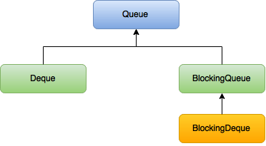
COLLECTION FRAMEWORK
4) Queue Interface:
Queue Interface extends the Collection interface to provide an implementation of a queue and provides the functionality to add, remove, access and examine queue elements.
Typically, queues implement a first-in first out behaviour and elements can be removed only from the head.
Queue is useful for represent a group of individual objects prior to processing.

Slide 88
COLLECTION FRAMEWORK
Example for Queue Interface:
import java.util.*;
class TestCollection {
public static void main(String args[]) {
PriorityQueue<String> queue=new PriorityQueue<String>();
queue.add("Monika");
queue.add("Darshan");
queue.add("Praveen");
queue.add("Suresh");
System.out.println("head:"+queue.element());
System.out.println("head:"+queue.peek());
System.out.println("iterating the queue elements:");
Iterator itr=queue.iterator();
while(itr.hasNext()){
System.out.println(itr.next());
}
// Continued
queue.remove();
queue.poll();
System.out.println("after removing two elements:");
Iterator<String> itr2=queue.iterator();
while(itr2.hasNext()){
System.out.println(itr2.next());
} } }
/* O/P - head:Darshan head:Darshan iterating the queue elements: Darshan Monika Praveen Suresh after removing two elements: Praveen Suresh */

Slide 89
COLLECTION FRAMEWORK
5) Map Interface:
The Map interface is a generic interface that provides a way to store key/value pairs. A map is an object that maps keys to values. Keys are unique and are used to identify values.
Both key and value are objects, duplicated keys are not allowed but values can be duplicated.

Slide 90
COLLECTION FRAMEWORK
Example for Map Interface:
import java.util.*;
class MapInterfaceExample {
public static void main(String args[]) {
Map<Integer,String> map=new HashMap<Integer,String>(); map.put(102, "Darshan");
map.put(101, "Monika");
map.put(103, "Praveen"); map.put(103, "Suresh");
for(Map.Entry m:map.entrySet()) {
System.out.println(m.getKey()+" "+m.getValue());
} }
} /* O/P - 101 Monika
102 Darshan
103 Suresh */

Slide 91
COLLECTION FRAMEWORK
Summarization of principal classes in Java collections framework:
Principal collection class | Base class | Base interfaces | Allow duplicate elements? | Ordered? | Sorted?
ArrayList<E> | AbstractList<E> | List<E> | Yes | Yes | No
LinkedList<E> | AbstractSequentialList<E> | List<E>; Deque<E> | Yes | Yes | No
Vector<E> | AbstractList<E> | List<E> | Yes | Yes | No
HashSet<E> | AbstractSet<E> | Set<E> | No | No | No
LinkedHashSet<E> | HashSet<E> | Set<E> | No | Yes | No
TreeSet<E> | AbstractSet<E> | Set<E>; NavigableSet<E>; SortedSet<E> | No | Yes | Yes
Queue<E> | AbstratQueue<E> | Collection<E> | Yes | Yes | No

Slide 92
CURSORS
Cursors:
Cursors are used to retrieve objects one by one from the collection.
There are three types of cursors:
Property | 1. Enumeration | 2. Iterator | 3. ListIterator
Applicable for | Only legacy classes | Any Collection classes | Only List classes
Movement | Only forward direction | Only forward direction | Both forward and backward direction
Accessibility | Only read access | Both read and remove | Read, Remove, Replace and addition of new object
How to get it? | By 2 methods hasMoreElements() nextElement() | By 3 methods hasNext() next() remove() | By 9 methods
 |  |  | hasNext() next() nextIndex() hasPrevious() previous() | 6. previousIndex() 7. remove() 8. set(Object new) 9. add(Object new)

Slide 93
COLLECTION FRAMEWORK
Example for Enumeration Cursor:
import java.util.*;
public class MyEnumeration {
public static void main(String a[]) {
Vector<String> lang = new Vector<String>();
Enumeration<String> en = null;
lang.add("JAVA");
lang.add("JSP");
en = lang.elements();
while(en.hasMoreElements()) {
System.out.println(en.nextElement());
} }
} /* O/P - JAVA
JSP */

Slide 94
COLLECTION FRAMEWORK
Example for Iterator Cursor:
import java.util.*;
public class MapInterfaceExample
{
public static void main(String[] args)
{
List<String> myList = new ArrayList<String>();
myList.add("Java");
myList.add(“JSP");
myList.add(“Servlet");
System.out.println(“Before remove:");
System.out.println(myList);
Iterator<String> itr = myList.iterator();
while(itr.hasNext())
// Continued
{
String removeElem = “JSP";
if(removeElem.equals(itr.next())) {
itr.remove();
}
}
System.out.println("After remove:");
System.out.println(myList);
}
} /* O/P - Before remove:
[Java, JSP, Servlet]
After remove:
[Java, Servlet] */

Slide 95
COLLECTION FRAMEWORK
Example for Iterator Cursor:
import java.util.*;
public class MyListIterator {
public static void main(String a[]) {
List<Integer> li = new ArrayList<Integer>();
ListIterator<Integer> litr = null;
li.add(25);
li.add(90);
li.add(35);
litr=li.listIterator();
System.out.println(“Forward direction");
while(litr.hasNext()) {
System.out.println(litr.next());
}
// Continued
System.out.println(“Backward direction");
while(litr.hasPrevious()) {
System.out.println(litr.previous());
}
}
} /* O/P - Forward direction
25
95
30
Backward direction
30
95
25 */

Slide 96
GENERICS
Generics:
Generics are given the ability to create generalized classes, interfaces and methods by operating through references of type Object.
It was added in Java 5 to provide compile-time type checking and removing risk of ClassCastException.
It provides compile-time type safety that allows programmers to catch invalid types at compile time and also expand ability to reuse code.
Advantages:
Type-safety : We can hold only a single type of objects in generics. It doesn’t allow to store other objects.
Type casting is not required : There is no need to typecast the object.
Compile-Time Checking : It is checked at compile time so problem will not occur at runtime.
Syntax: ArrayList<String>

Slide 97
COLLECTION FRAMEWORK
Example for Generics:
import java.util.*;
class TestGenerics1{
public static void main(String args[]){
ArrayList<String> list=new ArrayList<String>();
list.add("rahul");
list.add("jai");
//list.add(32);//compile time error
String s=list.get(1);//type casting is not required
System.out.println("element is: "+s);
Iterator<String> itr=list.iterator();
while(itr.hasNext()){
System.out.println(itr.next());
} } }

Slide 98
MULTI-THREADING
Multithreading:
Multithreading in java is a process of executing multiple threads simultaneously.
Both multiprocessing and multithreading are used to achieve multitasking.
Process | Threads
A process is a collection of one or more threads and associated system resources. | Threads are light-weight processes within a process .
Process can be divided into multiple threads | Threads cannot be sub divided.
Each process has its own memory space | Threads of the same process share a common memory space
It is difficult to create a process | It is easy to create a thread.

Slide 99
MULTI-THREADING
Multitasking is a process of executing multiple tasks simultaneously.
The multitasking types are:
1) Process-based Multitasking (Multiprocessing):
Each process have its own address in memory i.e. each process allocates separate memory area.
Process is heavyweight.
Cost of communication between the process is high.
Switching from one process to another require some time for saving and loading registers, memory maps, updating lists etc.
2) Thread-based Multitasking (Multithreading):
Threads share the same address space.
Thread is lightweight.
Cost of communication between the thread is low.

Slide 100
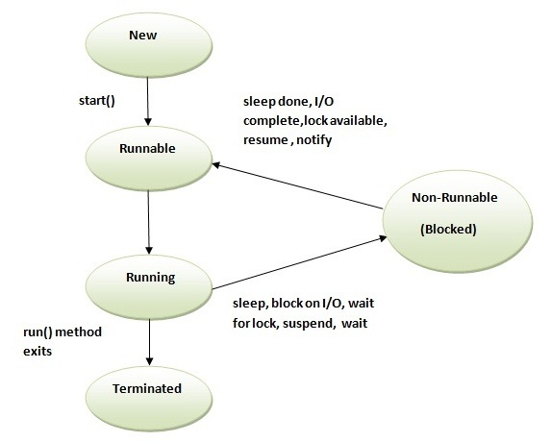
MULTI-THREADING
Life cycle of the thread:
During the life time of a thread, there are many states it can enter.
They include :
New
Runnable
Running
Non-Runnable
Terminated

Slide 101
MULTI-THREADING
Creation of Thread:
By extend thread class | By implementing Runnable interface
class Test extends Thread { public void run() { Sytem.out.println(" running..."); } public static void main(String args[]) { Test t1=new Test(); t1.start(); } } // O/P - running… | class Test2 implements Runnable { public void run() { System.out.println(“running..."); } public static void main(String args[]) { Test2 m1=new Test2(); Thread t1 =new Thread(m1); t1.start(); } } O/P - running...

Slide 102
MULTI-THREADING
Method used in Thread:
sleep() | join() | Yield()
Used to sleep a thread for the specified amount of time. | join() waits for a thread to die. | Yield() causes the current thread to temporarily pause its execution
Syntax: 1.public static void sleep(long miliseconds) throws InterruptedException 2. public static void sleep(long miliseconds, int nanos) throws InterruptedException | Syntax: 1.public static join()throws InterruptedException 2.public static join()(long miliseconds) throws InterruptedException | Syntax: 1. public static native void yield()

Slide 103
MULTI-THREADING
Naming Thread :
The Thread class provides methods to change and get the name of a thread. By default, each thread has a name i.e. thread-0, thread-1 and so on. By we can change the name of the thread by using setName() method.
The syntax of setName() and getName() methods are:
public String getName(): used to return the name of a thread.
public void setName(String name): used to change the name of a thread.

Slide 104
MULTI-THREADING
Thread Priority:
Each thread have a priority. Priorities are represented by a number between 1 and 10. In most cases, thread scheduler schedules the threads according to their priority (known as pre-emptive scheduling). But it is not guaranteed because it depends on JVM specification that which scheduling it chooses.
The Thread class defines several priority constants:
1. MIN_PRIORITY=1
2. NORM_PRIORITY=5
3. MAX_PRIORITY=10
The default setting is NORM_PRIORITY

Slide 105
MULTI-THREADING
Synchronization:
Synchronization in java is the capability to control the access of multiple threads to any shared resource.
Synchronization is better in case we want only one thread can access the shared resource at a time.
Synchronization is mainly used to prevent thread interference and consistency problem.
There are two types of synchronization:
Process Synchronization
Thread Synchronization

Slide 106
MULTI-THREADING
Thread synchronization:
Types of Thread synchronization:
1. Mutual Exclusive
It helps to keep threads from interfering with one another while sharing data.
Synchronized method
Synchronized block
Static synchronization
2. Co-Operation(Inter-thread communication)

Slide 107
MULTI-THREADING
Example for Synchronized Method:
class Table{ synchronized void printTable(int n) { for(int i=1;i<=5;i++) { System.out.println(n*i); try {
Thread.sleep(400); } catch(Exception e) {
System.out.println(e);
} } } } class MyThread1 extends Thread{ Table t; MyThread1(Table t){ this.t=t; } public void run() { t.printTable(5); } } public class Demo{ public static void main(String args[]){ Table obj = new Table(); //only one object MyThread1 t1=new MyThread1(obj); t1.start(); } }

Slide 108
MULTI-THREADING
Synchronized method | Synchronized block
If declare any method as synchronized, it is known as synchronized method. Synchronized method is used to lock an object for any shared resource. | Synchronized block can be used to perform synchronization on any specific resource of the method.
Syntax: Synchronized void methodname() | Syntax: synchronized (object reference expression) { //code block }

Slide 109
MULTI-THREADING
Static synchronization:
To make any static method as synchronized, the lock will be on the class not on object.
Deadlock:
Deadlock can occur in a situation when a thread is waiting for an object lock, that is acquired by another thread and second thread is waiting for an object lock that is acquired by first thread. Since, both threads are waiting for each other to release the lock, the condition is called deadlock.

Slide 110
MULTI-THREADING
Inter-thread Communication / Co-operation:
It is all about allowing synchronized threads to communicate with each other.
It is a mechanism in which a thread is paused running in its critical section and another thread is allowed to enter (or lock) in the same critical section to be executed.
It is implemented by following methods of Object class:
wait()
notify()
notifyAll()

Slide 111
MULTI-THREADING
Wait() | Notify() | NotifyAll()
Suspends execution of current thread | It moves only one waiting thread from waiting state to runnable state | It moves all waiting thread from waiting state to runnable state
Only used in synchronised context | Only used in synchronised context | Only used in synchronised context
It releases lock | It will give up the lock | It will give up the lock

Slide 112
EXCEPTION HANDLING
Exception Handling:
Exception is an event that interrupts the normal flow of the program that results to abnormal termination of program .
In java exceptional handling is a mechanism to handle the runtime errors so that normal flow of the application can be maintained.
Maintains the normal flow of the application.
Gives alternate way to normal flow. Or Graceful termination to the program.
Separates the normal code & risky code.
Example:
statement 1;
statement 2;
statement 3; //exception occurs
statement 4;
statement 5;
There are 5 statements in program and there occurs an exception at statement 3, rest of the code will not be executed i.e. statement 4 & 5 will not run. If we perform exception handling, rest of the statement will be executed..

Slide 113
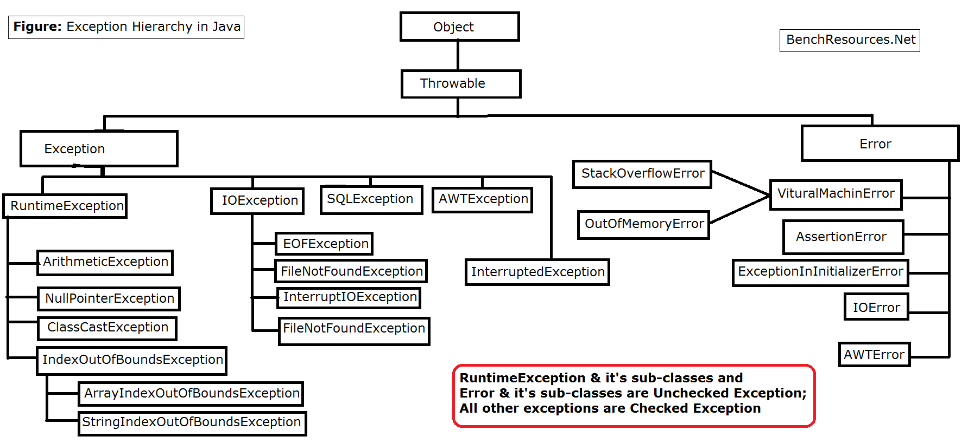
EXCEPTION HANDLING
Exception Hierarchy:

Slide 114
EXCEPTION HANDLING
Types of Exception :
The sun micro system says there are three types of exceptions:
Checked, Unchecked and Error.
There are mainly two types of exceptions: where error is considered as unchecked exception.
Checked Exception | Unchecked Exception
Subclass of Exception | Subclass of RunTimeException & Errors
Checked by compiler whether you are handling or not. | Not checked by compiler whether you are handling or not.
Force to developer to handle by either writing try/catch or throws. | Do not force to developer to handle.
Also called as Caught Exceptions | Also called as Uncaught Exceptions

Slide 115
EXCEPTION HANDLING
Keywords:
try { }
try block is used to enclose the code that might throw an exception.
It must be used within the method.
catch { }
catch block is used to statement which will catch the arisen exception.
finally { }
It is a block that is used to execute important code without fail like closing connection.

Slide 116
EXCEPTION HANDLING
Keywords (Continue.. ):
throw:
It is used to explicitly throw an exception. throw either checked or unchecked exception in java.
throws:
It is used to declare an exception. It gives an information to the programmer that there may occur an exception so it is better for the programmer to provide the exception handling code so that normal flow can be maintained.
Syntax: throw new IOException("sorry device error);
Syntax:
return_type method_name() throws exception_class_name{ //method code}

Slide 117
EXCEPTION HANDLING
Example for try, catch & finally keywords :
class TestBlocks{
public static void main(String args[]){
try{
int data=25/0;
System.out.println(data);
}
catch(ArithmeticException e) {
System.out.println(e); }
finally {
System.out.println("finally block executes always"); }
System.out.println("rest of the code...");
}
} /* java.lang.ArithmeticException: / by zero
finally block executes always
rest of the code */
Rule: For each try block there can be zero or more catch blocks, but only one finally block.

Slide 118
EXCEPTION HANDLING
Example for throw keyword:
public class TestThrow {
static void validate(int age) {
if(age<18)
throw new ArithmeticException("not valid");
else
System.out.println("welcome to vote");
}
public static void main(String args[]) {
validate(13);
System.out.println("rest of the code...");
}
} /* O/P:
Exception in thread main java.lang.ArithmeticException:not valid */

Slide 119
EXCEPTION HANDLING
Difference b/w throw & throws:
throw | throws
It is used to explicitly throw an exception. | It is is used to declare an exception
Checked exception cannot be propagated using throw only | Checked exception can be propagated with throws
Throw is followed by an instance | Throws is followed by class.
Throw is used within the method. | Throws is used along with method signature.
You cannot throw multiple exceptions | You can declare multiple exceptions public void method()throws IOException, SQLException

Slide 120
REG-EX
Regular Expressions:
The Java Regex or Regular Expression is an API to define pattern for searching or manipulating strings.
It is widely used to define constraint on strings such as password and email validation. We will be able to test our own regular expressions by the Java Regex Tester Tool.
Java Regex API provides 1 interface and 3 classe in java.util.regex package.
Classes and Interface:
java.util.regex package: It provides following classes and interface for regular expressions.
MatchResult (I)
Matcher (C)
Pattern (C)
PatternSyntaxException (C)

Slide 121
REG-EX
Matcher©:
It implements MatchResult(I).
It is a regex engine i.e. used to perform match operations on a
character sequence.
Methods | Description
boolean matches() | test whether the regular expression matches the pattern.
boolean find() | finds the next expression that matches the pattern.
String group() | returns the matched subsequence.
int start() | returns the starting index of the matched subsequence.
int end() | returns the ending index of the matched subsequence.

Slide 122
REG-EX
Pattern(C):
It is the compiled version of a regular expression.
It is used to define a pattern for the regex engine.
Methods | Description
static Pattern compile(String regex) | compiles the given regex and return the instance of pattern.
Matcher matcher (CharSequence input) | creates a matcher that matches the given input with pattern.
String[] split(CharSequence input) | splits the given input string around matches of given pattern.
String pattern() | returns the regex pattern.

Slide 123
REG-EX
Character(C):
It is used to match only one out of several characters.
Methods | Description
[abc] | a, b, or c (simple class)
[^abc] | Any character except a, b, or c (negation)
[a-zA-Z] | a through z or A through Z, inclusive (range)
[a-d[m-p]] | a through d, or m through p: [a-dm-p] (union)
[a-z&&[^bc]] | a through z, except for b and c: [ad-z] (subtraction)
[a-z&&[^m-p]] | a through z, and not m through p: [a-lq-z](subtraction)

Slide 124
REG-EX
Example for Regular Expression:
class RegexExample{
public static void main(String args[]) { System.out.println("by character classes and quantifiers ...");
System.out.println(Pattern.matches("[789]{1}[0-9]{9}", "9953038949")); // O/P - true
System.out.println(Pattern.matches("[789][0-9]{9}", "9953038949")); // O/P - true
System.out.println(Pattern.matches("[789][0-{9}", "99530389490")); // O/P - false (11 chars)
System.out.println(Pattern.matches("[789][0-9]{9}", "8853038949")); // O/P - true
}
}

Slide 125
ANNOTATIONS
Annotations:
It is a tag that represents the metadata i.e. attached with class, interface, methods or fields to indicate some additional information which can be used by java compiler and JVM.
It is an alternative option for XML and java Marker Interfaces.
Annotations are executed by predefined tool APT(Annotation Processing Tool).
Types of Annotations:
Built-In Java Annotations
Custom Annotation

Slide 126
ANNOTATIONS
1.1 Built-In Annotations used in java code
@Override
@SuppressWarnings
@Deprecated
1.2 Built-In Annotations used in other annotation
@Target
@Retention
@Inherited
@Documented

Slide 127
ANNOTATIONS
Built-In Annotations:
@Override:
It assures that the subclass method is overriding the parent class method. If it is not so, compile time error occurs.
@SuppressWarnings:
It is used to suppress warnings issued by the compiler.
@Deprecated:
It marks that this method is deprecated so compiler prints warning. It informs user that it may be removed in the future versions. So, it is better not to use such methods.

Slide 128
ANNOTATIONS
Java Custom Annotation:
Easy to create and use.
The @interface element is used to declare an annotation.
Few points for custom annotation signature:
Method should not have any throws clauses.
Method should return one of the following:
primitive data types, String, Class, enum or array of these data types.
Method should not have any parameter.
It may assign a default value to the method.
Example: @interface MyAnnotation{}

Slide 129
ANNOTATIONS
Types of Custom Annotation:
1. Marker Annotation
2. Single-Value Annotation
3. Multi-Value Annotation
1) Marker Annotation: An annotation that has no method.
The @Override and @Deprecated are marker annotations.
2) Single-Value Annotation: An annotation that has one method.
Example: @interface MyAnnotation{}
Example: @interface MyAnnotation{ int value(); }

Slide 130
ANNOTATIONS
3) Multi-Value Annotation: An annotation that has more than one method.
Providing the default value.
Example: @interface MyAnnotation {
int value1();
String value2();
}
Example: @interface MyAnnotation {
int value1() default 1;
String value2() default "xyz";
}

Slide 131
ANNOTATIONS
Built-in Annotations used in custom annotations in java are:
@Target, @Retention, @Inherited, @Documented
@Target: It is used to specify at which type, the annotation is used.
The java.lang.annotation.ElementType enum declares many constants to specify the type of element where annotation is to be applied such as TYPE, METHOD, FIELD etc. The constants of ElementType enum are:
Element Types | Where the annotation can be applied
TYPE | class, interface or enumeration
FIELD | fields
METHOD | methods
CONSTRUCTOR | constructors
LOCAL_VARIABLE | local variables
ANNOTATION_TYPE | annotation type
PARAMETER | parameter

Slide 132
ANNOTATIONS
Example: To specify annotation for a class
@Target(ElementType.TYPE)
@interface MyAnnotation{
int value1();
String value2();
}
Example: To specify annotation for a class, methods or fields
@Target({ElementType.TYPE, ElementType.FIELD, ElementType.METHOD}) @interface MyAnnotation{
int value1();
String value2();
}

Slide 133
ANNOTATIONS
@Retention: It is used to specify to what level annotation will be available.
RetentionPolicy | Availability
RetentionPolicy.SOURCE | refers to the source code, discarded during compilation. It will not be available in the compiled class.
RetentionPolicy.CLASS | refers to the .class file, available to java compiler but not to JVM. It is included in the class file.
RetentionPolicy.RUNTIME | refers to the runtime, available to java compiler and JVM.
Example: To specify the RetentionPolicy
@Retention(RetentionPolicy.RUNTIME)
@Target(ElementType.TYPE)
@interface MyAnnotation{
int value1();
String value2();
}

Slide 134
ENUM
Java Enum:
It is a data type that contains fixed set of constants.
It can be used for days of the week (SUNDAY, MONDAY, TUESDAY, WEDNESDAY, THURSDAY, FRIDAY and SATURDAY) , directions (NORTH, SOUTH, EAST and WEST) etc. The java enum constants are static and final implicitly. It is available from JDK 1.5.
Advantages of Java enum:
Improves type safety
Easily used in switch
Traversed
It can have fields, constructors and methods
It may implement many interfaces but cannot extend any class because it internally extends Enum class

Slide 135
ENUM
Enum has constructors. Except of constructors, an Enum is an ordinary class.
Each name listed within an Enum is actually a call to a constructor
Enum constructors are only available within the Enum itself
Example for Enum:
class EnumExample4 {
enum Season {
WINTER(5), SPRING(10), SUMMER(15), FALL(20);
private int value;
private Season(int value) {
this.value=value;
} }
public static void main(String args[]) {
for (Season s : Season.values())
System.out.print(s+" "+s.value);
} } // O/P - WINTER 5 SPRING 10 SUMMER 15 FALL 20

Slide 136
FAQ’s
Java Fundamentals:
What is JVM and Is it platform independent?
What is difference between JDK and JVM and JRE?
Why Java is not pure Object Oriented language?
What are principle concepts of OOPS?
What is Java Package and which package is imported by default?
What is Overloading and Overriding in Java?
What is the difference between an Inner Class and a Sub-Class?
What is the difference between abstract class and interface?
What is static binding and dynamic binding?
What is Data Encapsulation and what’s its significance?

Slide 137
FAQ’s
Java Fundamentals: (Continue..)
11. What is Java Bean Class?
12. What are Access modifiers?
13. What’s the benefit of using inheritance?
14. Why multiple Inheritance not supported in Java?
15. What is the diamond problem in inheritance?
16. What is the difference between break and continue statement?
17. What is nested class?
18. How are this() and super() used with Constructor?
19. What is Serialization and Deserialization
20 What is difference between Heap and Stack Memory?

Slide 138
FAQ’s
Array:
What do you mean by an Array? How to create?
What are advantages and disadvantages of Array?
What is the meaning of anonymous array? Explain with an example?
What are “jagged” arrays in java?
How to copy an array into another array?
What is the step to access elements of an array in Java?
How to sort an array in Java?
What is difference between ArrayIndexOutfOBounds and ArrayStoreException?
How to check array contains value or not?
Where does array stored in memory?

Slide 139
FAQ’s
String :
What is String in Java?
What are different ways to create String Object?
What is String subSequence method?
How to convert String to char and vice versa?
How to convert String to byte array and vice versa?
Difference between String, StringBuffer and StringBuilder?
Why String is immutable or final in Java?
What is String Pool?
What does String intern() method do?
Why String is popular HashMap key in Java?

Slide 140
FAQ’s
Collections :
What is Java Collections Framework? List out some benefits of Collections framework?
What is the benefit of Generics in Collections Framework?
What are the basic interfaces of Java Collections Framework?
What are common algorithms implemented in Collections Framework?
Why Collection doesn’t extend Cloneable and Serializable interfaces?
What is difference between Array and ArrayList? When will you use Array over ArrayList?
What are similarities and difference between ArrayList, Linked List and Vector?
Why Map interface doesn’t extend Collection interface?
What is difference between Enumeration and Iterator interface?
What is difference between Stack and Queue?
What is difference between Comparable and Comparator interface?
How HashMap works in Java?
What are different Collection views provided by Map interface?

Slide 141
FAQ’s
Multithreading :
What is the difference between Process and Thread?
What are the benefits of multi-threaded programming?
What is difference between user Thread and daemon Thread?
How can we create a Thread in Java?
What are different states in lifecycle of Thread?
What is Thread Scheduler and Time Slicing?
What is context-switching in multi-threading?
How does thread communicate with each other?
Why thread communication methods wait(), notify() and notifyAll() are in Object class?
Why wait(), notify() and notifyAll() methods have to be called from synchronized method or block?
Why Thread sleep() and yield() methods are static?
How can we achieve thread safety in Java?
What is Deadlock? How to analyze and avoid deadlock situation?
What is Java Timer Class? How to schedule a task to run after specific interval?
What is Thread Pool? How can we create Thread Pool in Java?

Slide 142
FAQ’s
Exception Handling :
What is Exception & Exception Handling in Java?
What are the Exception Handling Keywords in Java?
Explain Java Exception Hierarchy?
What are important methods of Java Exception Class?
What is difference between Checked and Unchecked Exception in Java?
What is difference between throw and throws keyword in Java?
How to write custom exception in Java?
What are different scenarios causing “Exception in thread main”?
What is difference between final, finally and finalize in Java?
What happens when exception is thrown by main method?

Slide 143
FAQ’s
Regular Expressions :
What is Regex ? Why we go for regex?
What are the classes in Java that helps to deal with regular expressions?
What is a metacharacter?
What are predefined character classes?
Which is regex engine class?
Which is compiler of regex?
What are advantages of regex?

Slide 144
FAQ’s
Annotations :
What are annotations? What are their typical use cases?
Describe some useful annotations from the standard library.
How can you create an annotation?
What object types can be returned from an annotation method declaration?
Which program elements can be annotated?
What are meta-annotations?
What are repeating annotations?

Slide 145
FAQ’s
Enum :
What is enum? Why we go for enum?
Can Enum implement interface in Java?
Can Enum extends class in Java?
Can we declare Constructor inside Enum?
Can we override toString() method for Enum? What happens if we don't?
How do you create Enum without any instance? Is it possible without compile time error?

Slide 146

1

